Slide 1
Lourdes Primary School
Getting It Right For Every Child
Parent Questionnaire Results 2014/15

Slide 2
Safe – It is important that everybody feels safe. We all need someone who helps us feel safe and protected from harm.

Slide 3
Safe – It is important that everybody feels safe. We all need someone who helps us feel safe and protected from harm.

Slide 4
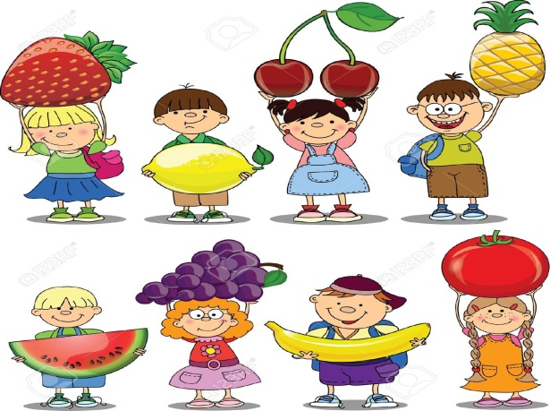
Healthy – We all like to be as healthy as we can be.

Slide 5
Healthy – We all like to be as healthy as we can be.

Slide 6
Healthy – We all like to be as healthy as we can be.

Slide 7
Achieving – Every child should have people who encourage them to learn and do their best.

Slide 8
Achieving – Every child should have people who encourage them to learn and do their best.

Slide 9
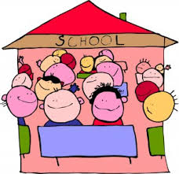
Nurtured – Children need a place where they can feel comfortable and safe and where people really care about them.

Slide 10
Nurtured – Children need a place where they can feel comfortable and safe and where people really care about them.

Slide 11
Active – Children enjoy spending time doing something fun or interesting.

Slide 12
Active – Children enjoy spending time doing something fun or interesting.

Slide 13
Active – Children enjoy spending time doing something fun or interesting.

Slide 14
Respected – It is important that children are involved in decisions that affect them.

Slide 15
Respected – It is important that children are involved in decisions that affect them.

Slide 16
Respected – It is important that children are involved in decisions that affect them.

Slide 17
Respected – It is important that children are involved in decisions that affect them.

Slide 18
Responsible – Growing up involves learning to take good decisions and make sensible choices.

Slide 19
Responsible – Growing up involves learning to take good decisions and make sensible choices.

Slide 20
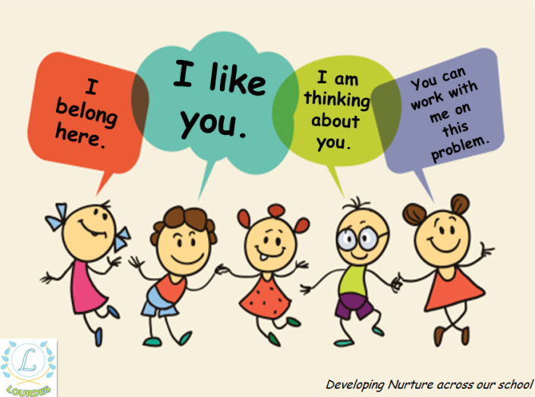
Included – Growing up involves learning to take good decisions and make sensible choices.

Slide 21
Included – Growing up involves learning to take good decisions and make sensible choices.

Slide 22
Included – Growing up involves learning to take good decisions and make sensible choices.

